Slide 1
The Philosophy of Resilience Leadership

Slide 2
Today’s Topics
Resilience: Mindstate, Problems and Solutions
Eudaimonia
My Background
Philosophy and Resilience Leadership at the Community Level
Hawai’i and the Lōkahi Wheel
Resilience Leadership
Your Community

Slide 3
What is Eudaimonia?
Notes:
[Ask if anyone wants to share a centered and exhilarated memory. If nobody shares, offer your own story of walking through the botanical gardens. Note how Centered and Exhilarated both have their own spectrum. Give an example of resonance and dissonance. Notice how the both have their own spectrum.]
This is what it’s like to have depolarized thinking. I like to call it Both/And, because you can come up with really good solutions to problems when you’re in this space.
In this space, you know what’s best for you. You have an internal wisdom. And you’re embodied, so you can actually feel what your body is telling you. If you’re hungry or lonely or happy, those are all feelings that you can sense in your body and Eudaimonia is a state that gives us more access to how we’re actually feeling, instead of just the thoughts in our head when we’re stressed. Stress is a step away from Eudaimonia. Cortisol is a stress hormone, and when it activates, it causes our body to step into an auto-pilot type of functioning, where our body makes our decisions for us. This is called the sympathetic nervous system and it reduces our thoughts to a simple spectrum of something being good or bad. Pleasure or pain. And it wants to move towards pleasure and away from pain.

Slide 4
Living in Virtue
Eudaimonia
Hedonism
turn attention towards the soul
by harmonizing our desires
pacify the mind
divine-like state of tranquility
the process of maximizing pleasure while minimizing pain
utilitarian “goodness”
Notes:
Living in Virtue: When experiencing Eudaimonia, your mind is open because your experience is open. You’re taking in data from the 5 senses easily and you can juggle multiple concepts in your thoughts, which makes you better in situations of advanced difficulty, because you can come up with a more optimal solution. In this way, it feels like you’re in connection with all beings so you’re making decisions not just for yourself, but for your relationships with others and the world around you as well.
Eudaimonia as a source of “goodness” is a position only in Moral Realism and even then only in the sub-branch of Non-naturalism. But 69% of philosophers say they are moral realists, according to the PhiloPapers release in 2020.
Anhedonia is commonly defined as the inability to experience pleasure or enjoyment from activities that would normally be pleasurable. It is a core symptom of depression and is often used to diagnose the disorder.

Slide 5
Resilience in Teams
Supportive Statements
Two Truths
Supportive Questions
Two Truths: Always call out two truths when you see it. This helps build a team’s active listening.
Support: Always remind teammates that you don’t know what’s best for them, so they need to tell you what’s best for them, so that you can be supportive. Go slow to go fast.
“Is there a way we can make this feel more supportive?”: Don’t allow people to walk all over you but don’t stand in the way of progress either.
Notes:
Working on the band-aid solution can be very stressful. Usually the retro-fit is less stressful and the Ideal Solution tends to be the least stressful.
You’ll often see people with hypersensitivity sorting towards prepping the Retro-fit or Ideal Solutions while people with thick skin and a lot of resilience are working on the Band-aid Solution.
But this is just in general. The typical real-world experience is that you could be leading all three at the same time. If your restaurant floods, you’ll already be thinking about coordinating your team to get the water out, to put up sandbags for the retrofit perhaps, and then to elevate your restaurant or move to a new location, for the Ideal Solution.

Slide 6
Resilience as a Leader
Who are you?
Notes:
Working on the band-aid solution can be very stressful. Usually the retro-fit is less stressful and the Ideal Solution tends to be the least stressful.
You’ll often see people with hypersensitivity sorting towards prepping the Retro-fit or Ideal Solutions while people with thick skin and a lot of resilience are working on the Band-aid Solution.
But this is just in general. The typical real-world experience is that you could be leading all three at the same time. If your restaurant floods, you’ll already be thinking about coordinating your team to get the water out, to put up sandbags for the retrofit perhaps, and then to elevate your restaurant or move to a new location, for the Ideal Solution.

Slide 7
• Anger (lower eyebrows drawn together, tense and narrowed eyes and lips
• Disgust - lips pulled up and nose crinkling
• Fear - upper white of eyes are revealed as the eyebrows raise and the mouth stretches open (to take in more light and air)
• Surprise - similar to fear with upper white of eyes being slightly revealed but with rounded eyebrows and relaxed lips (signals group to alertness)
• Sadness - inward corner of eyebrows drawn inwards and upwards, drooping eyes and a downturned mouth, signals something is wrong
• Happiness - lips drawn up and back and raised cheeks, causing wrinkling around the eyes
Blind and sighted athletes displayed the same emotions as each other when winning or losing matches.
– Sophie Zadeh

Slide 8
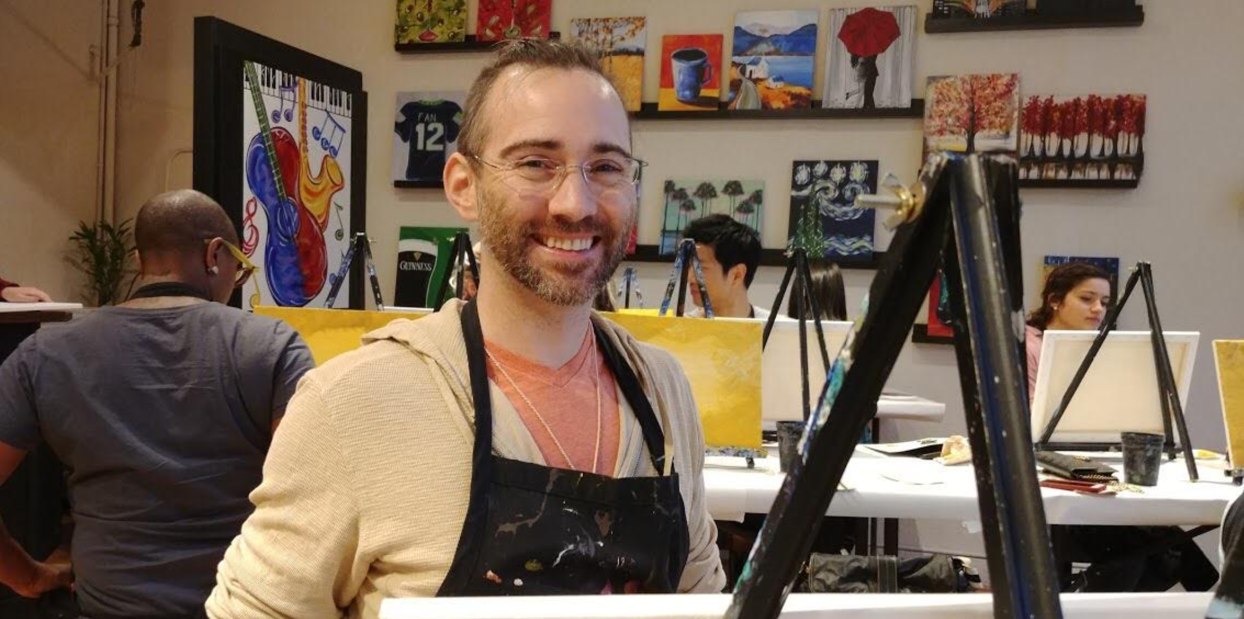
My Background
Project Aristotle
Multi-million dollar 5 year study in 2012 of 160 teams across Google.
Findings: Feeling safe to ask the questions you need to ask, to feel seen and feel heard, is the single shared factor across top-performing teams.
Consulting
I consult for small, medium and transnational corporations to implement culture and programs that foster dialogue. These are safe space conversations to learn how to express, to feel seen and feel heard, with the purpose of cultivating top-performing teams.

Slide 9
What is philosophy? What is a philosopher?
Philosophy
Philosopher
The love of wisdom
  Philo = Love
  Sophia = Wisdom (Gnosis, Eudaimonia)
Someone who explores and shares their love of wisdom with others.
Someone who questions everything out of a love of experiencing wonder and wanting to share it with others.

Slide 10
Philosophy and Community Resilience
Classical
  Stoicism
    Eudaimonia (happiness) came from internal beliefs and decisions, not external circumstances
    All humans can develop this virtue towards self-resilience
    Resilience slowly replaces irrational behavior with more rational behavior
Modern
  Phenomenology
    We are always in relationship with others.
    Husserl – Lifeworld (Lebenswelt)
    Heidegger – Being-in-the-World (In-der-Welt-Sein)
    Both Husserl and Heidegger suggest we start with our relationship to each other and the world around us.
Notes:
Classical
The ancient Greek and Roman philosophy of Stoicism (~200-100 BC) promoted resilience during situations of advanced difficulty. Eudaimonia was seen as dependent on virtue of character instead of external goods. All humans were seen as able to develop virtue. This type of resilience helps steer the irrational decisions back towards the rational decisions.
Cons: They believe it was built in our nature to act this way. Then why didn’t we? Why did we need a philosophy? Could the focus on the individual have missed something important?
Modern
Husserl came to realize the importance of factoring others’ influence upon one’s intentional content in perception, which he takes as the basis of social action. Deep down, Husserl was still convinced that rationality is our sole explanatory means of the world. The change was that he came convinced that such an endeavor cannot be bore by a single individual by him/herself — we are always affected by others and others affect us, even at the epistemological level. To understand the ideas of community, of resilience, and leadership in resilience at the community level, Husserl would suggest we first look at how we stand in relation to the world. This is what he calls "Phenomenology".
Cons: Is there anything missing? We know we’re in relation to each other. We know a disaster could happen. We know we don’t know what to do. Why aren’t we naturally taking effective action and giving high fives and resting and eating fruit?
Possible other topics if there is time:
Present Day
Robert Sapolsky teaches that a group of beings will share a wisdom with each other within their felt sense. This is similar to the Lifeworld presented by Hegel or the x presented by Heidegger.
Hegel
Hegel's purpose statement was to transform philosophy as the love of knowing into actual knowing. He was able to create an encyclopedia of philosophical techniques that are as simple as possible to accurately pin down meaning in a conversation, if you go slow enough.
Con: No was has time or resources for that.

Slide 11
The students of Husserl and Heidegger
Friedrich Nietzsche – Life-affirmation through embracing existence and the will to power.
Jean-Paul Sartre – Popularized Existentialism. Meaning through choice and freedom.
Hannah Arendt – Life-affirming engagement through politics and activism.
Maurice Merleau-Ponty – Emphasis on embodiment and connection to the world.
Emmanuel Levinas – Ethical meaning found in relationships with others.
Martin Buber – Meaning through authentic dialogue (I and Thou).
Viktor Frankl – Meaning even in suffering (Man’s Search for Meaning).
Hans-Georg Gadamer – Understanding as enriching human life.
Martin Heidegger (later works) – Wonder and openness to existence (Gelassenheit).
Albert Camus – Embracing life despite absurdity (The Myth of Sisyphus).

Slide 12
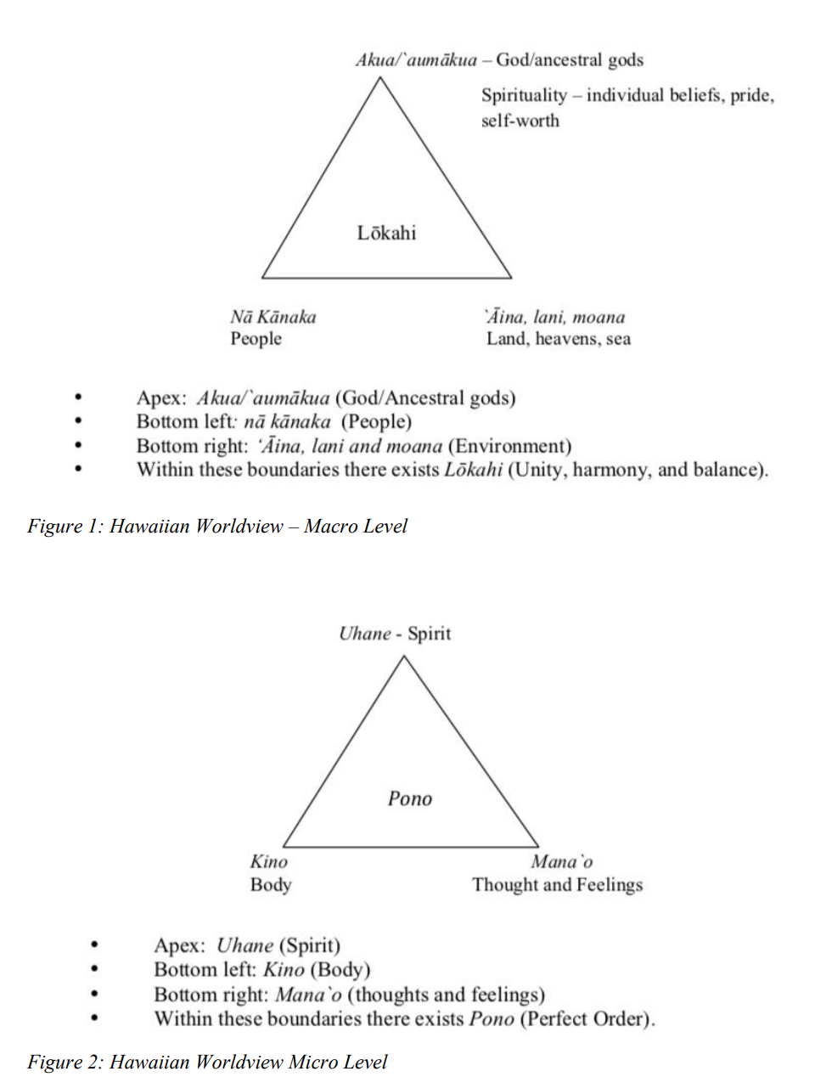
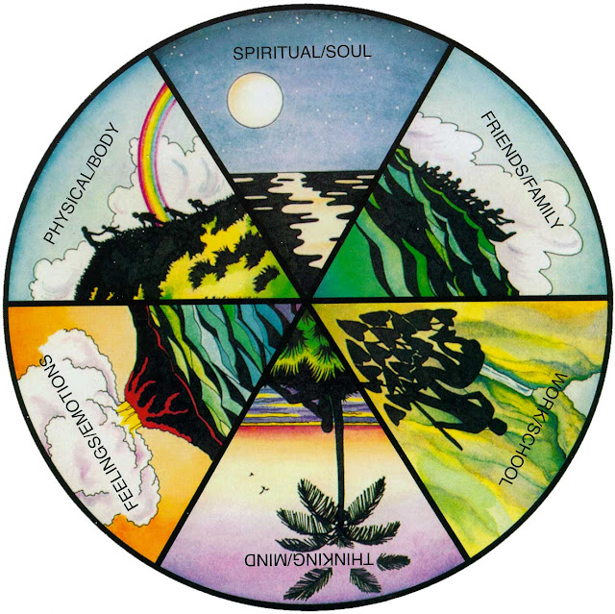
Claudia Voeks' LŌKAHI Wheel:
Notes:
Lōkahi Concept: The word lōkahi in general means balance. However, the Hawaiian concept of lōkahi encompasses much more.
It explains that the body (ke kino), the mind (ka mana‘o), the spirit (ka uhane) and the world (ka honua) are all interconnected and affect each other.
Without any one of these four elements, balance is impossible. It is the essence of Hawaiian group consciousness, the belief that harmony within the group will insure the cohesiveness and survival of the group and that group members are interdependent.
So in many ways, you can see the lōkahi wheel is a map of the 6 core aspects that relate to Eudaimonia within our self, as balance, while balancing the aspects of our social life. And we can do that! When our mind body and spirit is in a good place, we can feel in balance. Even during situations of adversity.
“Does anyone have an experience with the Lōkahi wheel or an experience with learning about pono or even aloha? Or does anyone have an Auntie who shared this information with them in their family culture around how to live in this way?”

Slide 13
How Can You Be a Resilience Leader in Your Community (Part 1)?
The Prerequisite
    Develop the skills to stay calm and centered in your own self during difficulty, so that you can hold the container of the group during difficulty.
    What do you do to find calm?
Notes:
How do you implement all this? There are three steps and one critical prerequisite to these three steps.
1. Develop the skills to stay calm and centered in your own self as you then engage in the next three steps. This is a prerequisite. What do you do to stay resilient?
(Miku and KH presented about this very topic at the Cerene seminar).

Slide 14
Sort the Solutions on the Fly During Problem Solving
Band-aid Solution – Activism is a great example of this. It’s an urgent action that needs to be taken to make immediate change happen (“to stop the bleeding”).
Retro-fit Solution – This solution can occur in parallel to the Band-Aid solution and is preparing a foundation for a more long-term approach with reducing the problem from occurring to begin with or making it possible to transition to the Ideal Solution
Ideal Solution – Follows on the retro-fit solution and makes a solid foundation for living in a way that promotes thriving while eliminating the problem.
Leadership Experience
Band-aid Solution
Ideal Solution
Retro-fit Solution
Notes:
Working on the band-aid solution can be very stressful. Usually the retro-fit is less stressful and the Ideal Solution tends to be the least stressful.
You’ll often see people with hypersensitivity sorting towards prepping the Retro-fit or Ideal Solutions while people with thick skin and a lot of resilience are working on the Band-aid Solution.
But this is just in general. The typical real-world experience is that you could be leading all three at the same time. If your restaurant floods, you’ll already be thinking about coordinating your team to get the water out, to put up sandbags for the retrofit perhaps, and then to elevate your restaurant or move to a new location, for the Ideal Solution.

Slide 15
Diverse Perspectives
Social Context
Cultural Context
Political Context
Economic Context
Group Talk
Context 1
Context 3
Context 2
Notes:
Dr. David Bohm studied group discussions for over four decades and published his findings in the book “On Dialogue”. His studies suggest that a group discussion can move naturally from problem to solution so long as there are between 6 – 60 people present and there is a leader that is facilitating the conversation with the goal of arriving at a shared understanding of each individuals perspective.
For ongoing discussions, or for the purposes of implementing programs for community resilience, it is also important to capture the notes from the meetings and to make the notes accessible.
Husserl also teaches us the importance of taking into account the individuals relationship to the content of the discussion. This includes their socio/cultural/political/economic contexts. If everyone shares the same context then this difference becomes less meaningful. But in matters of community resilience, it is often the case that these contexts are truly meaningful and the discussion can only be truly productive when they are accounted for.

Slide 16
How Can You Be a Resilience Leader in Your Community (Part 2)?
After the prerequisite, there are three steps:
Identify the contexts (socio / cultural / political / economic)
Gather the discussion (6 – 60 people with adequate representation across contexts)
Identify a location where people can access the notes and summaries of the conversation (phase 1), including current action items (phase 2), and progress measurement (phase 3). A website works well for this.

Slide 17
Phases of Community Resilience Projects
Data Gather (aka Community Dialogue Circle)
Operationalization Operationalization means turning abstract concepts into measurable observations
Measure and Report
Notes:
If a community could benefit from improved resilience, the Stoics would say that is because there is an adversity that is difficult to deal with.
So the first order of business is to get representatives from the relevant contexts together in a room to discuss. As shared meaning is reached, the discussion will naturally turn into proposals for solutions.
At this point, the group will need to define measurement criteria, so that if they’re receiving financial assistance, they can report on how it will be used.
And the final phase of course is to apply the measurements and then report on your measurements.

Slide 18
O’ahu Resilience Score = 3.9 / 10

Slide 19
Question Everything
I can’t know what’s best for you, society can’t know what’s best for you, only you can know what’s best for you, because only you can feel your Eudaimonia. Your felt sense of truth. Your resonances and dissonances.
Notes:
That’s my presentation. Please remember that Philosophy started as the love of wisdom which only much later led to Phenomenology, which brought in the importance of relationship to each other for every single aspect of life.
the Philosophy of Resilience we spoke about today is historical. It’s an account of what ideas have risen through philosophical scrutiny. But remember what Socrates teaches us from 3,000 years ago. It is only through questioning everything that humans have arrived at this set of philosophical knowledge. And that hasn’t changed, one of the most famous philosophers in the last century, Nietsze, devoted his lifeworks to conveying the importance of philosophy as questioning everything.
I love to frequently question all my beliefs. Nothing is immune to scrutiny. And I really do wish the same for you. Whether you’re choosing to walk the life of a philosopher, or if you’re choosing to be a resilience leader. Everything you learn along the way, revisit it, requestion it, submit everything to questioning.

Slide 20
Thank you!
Any questions?
Notes:
Thank you. Any questions?

Slide 21
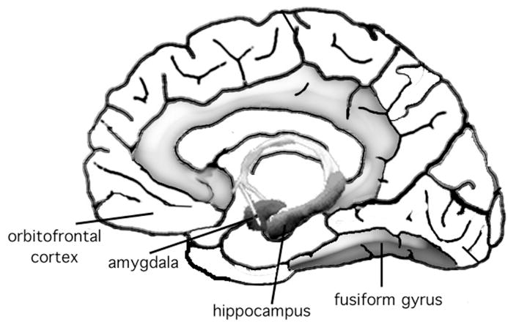
Appendix - Negative Mental Rehearsal
We remember our 5 senses more in negative memories, versus memories with a positive valence, but neutral memories that weren't encoded with a valence are much more difficult to remember accurately.
Of course, visual is the primary sense of the 5 senses in terms of our survival, and the visual encoding seems to be the most dynamic in alignment with these findings. The visual sense is very prominent in increased accuracy with recall of negative memories. Much more than positive and much much more than neutral. The thought is this helped us to survive.
The memory boost for emotional information seems to occur because affective processing regions (e.g., the amygdala and the orbitofrontal cortex) modulate the processing of regions that facilitate encoding of sensory detail (fusiform gyrus) and memory consolidation (hippocampal formation).

